Slide 1

Sage
Designing for an Active Transition into a Retirement Lifestyle
Adam Barry, Amy Chang, Ethan Hellman, Brendan McLoughlin
CS 147 · F23 · Stanford University

Slide 2

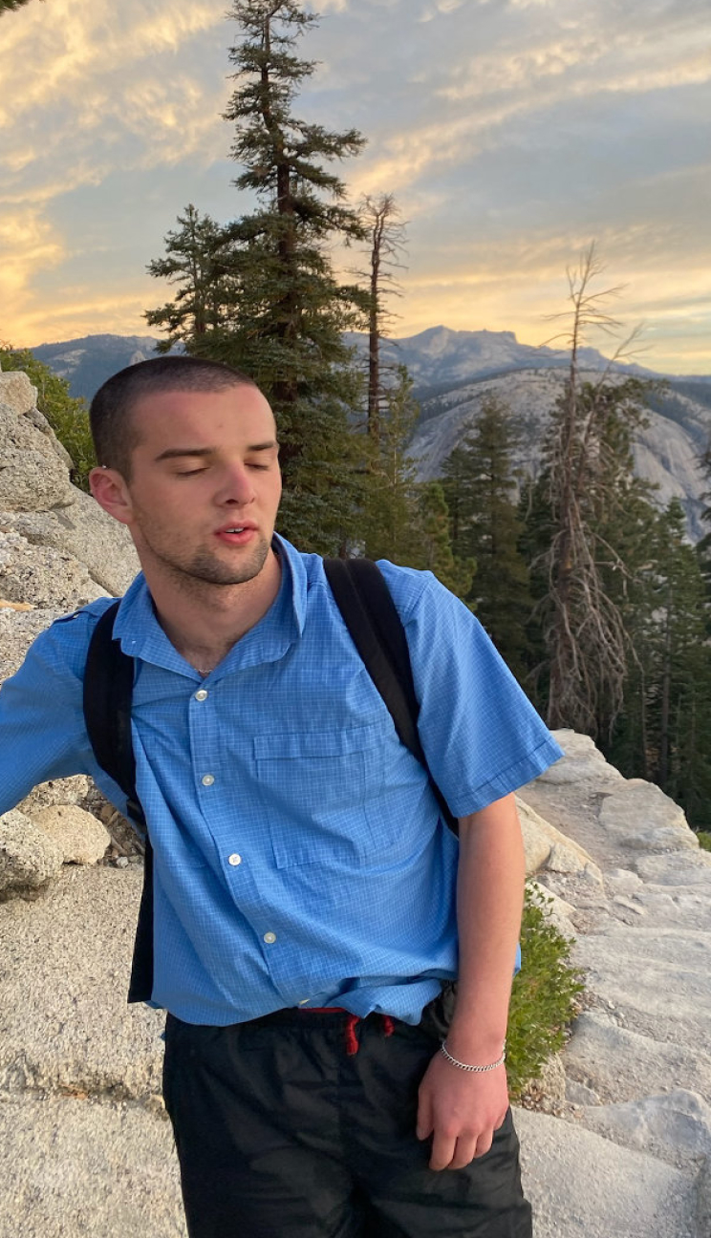
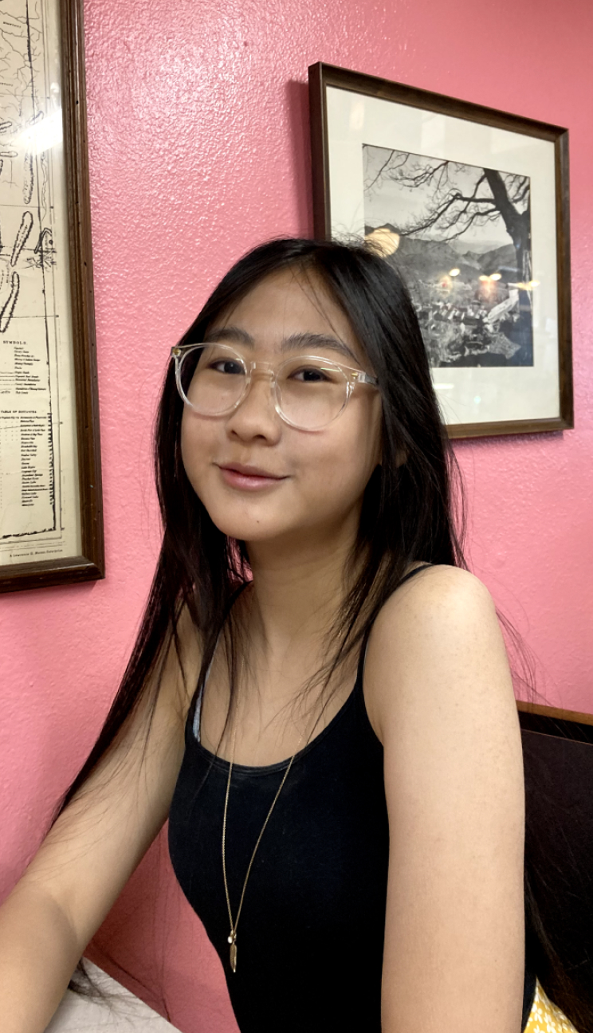
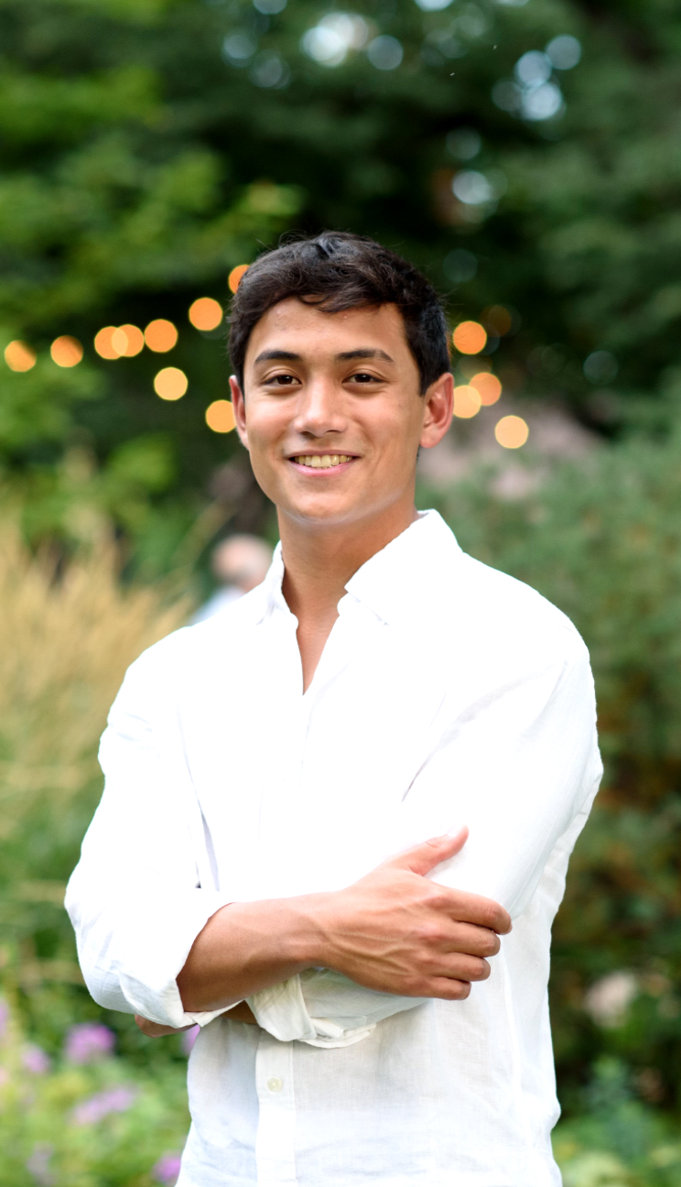
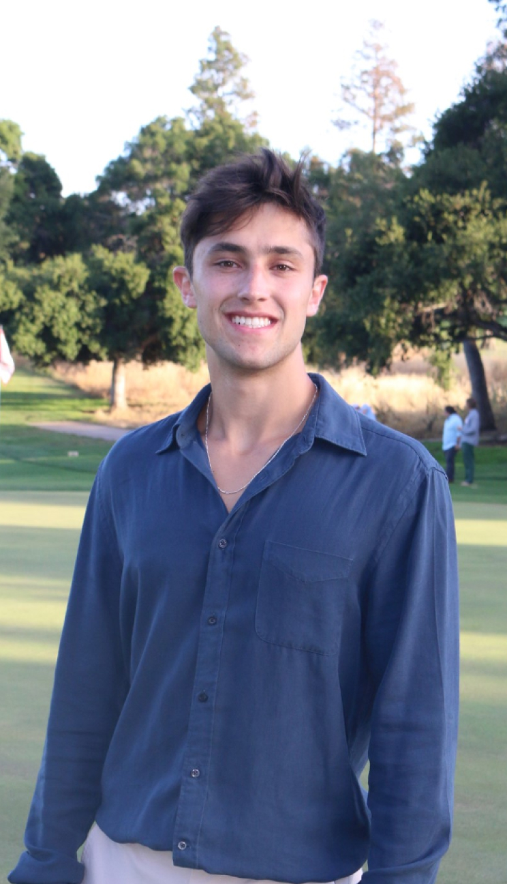
Team
Name: Adam Barry Year: Junior Major: Computer Science (HCI)
Name: Amy Chang Year: Junior Major: Computer Science (HCI)
Name: Ethan Hellman Year: Senior Major: Computer Science (AI)
Name: Brendan McLoughlin Year: Senior Major: Computer Science (HCI)

Slide 3
Sage

Slide 4
Outline
Problem & Solution Sketching Explorations Selected Interface & Rationale Low-fi Prototype Construction Task Flows Testing Methodology Testing Results Discussion

Slide 5

Problem & Solution
Back to our POV
WE MET
WE WONDER IF THIS MEANS
Mary-Lue Timpson (MLT), an 80-year-old who volunteers at Senior center
Feels different from other seniors due to role in the community which gives her a greater sense of purpose.
WE WERE SURPRISED TO LEARN:
IT WOULD BE GAME-CHANGING TO
MLT considers herself separate from the other seniors.
Deliver a similar sense of purpose through responsibility to more people.

Slide 6

Problem & Solution
Back to our POV
WE MET
THE GREATER PROBLEM
WE WONDER IF THIS MEANS
Elderly people who lack community and contribution to something bigger than themselves often feel lonely and purposeless
Mary-Lue Timpson (MLT), an 80-year-old who volunteers at Senior center
Feels different from other seniors due to role in the community which gives her a greater sense of purpose.
WE WERE SURPRISED TO LEARN:
IT WOULD BE GAME-CHANGING TO
MLT considers herself separate from the other seniors.
Deliver a similar sense of purpose through responsibility to more people.

Slide 7

Problem & Solution
Needs & solution
NEEDS
Create sense of purpose
Prevent loneliness
SOLUTION
Facilitate creation of shared gardens that donate their harvest.

Slide 8


VALUE PROP
Creating newfound purpose and friendships through gardening

Slide 9

Problem & Solution
Solution
2.
3.
Select a physical community garden
Attend gardening sessions with friends working towards harvest goals
Donate fruits of labor to community causes

Slide 10
Sketching Explorations

Slide 11
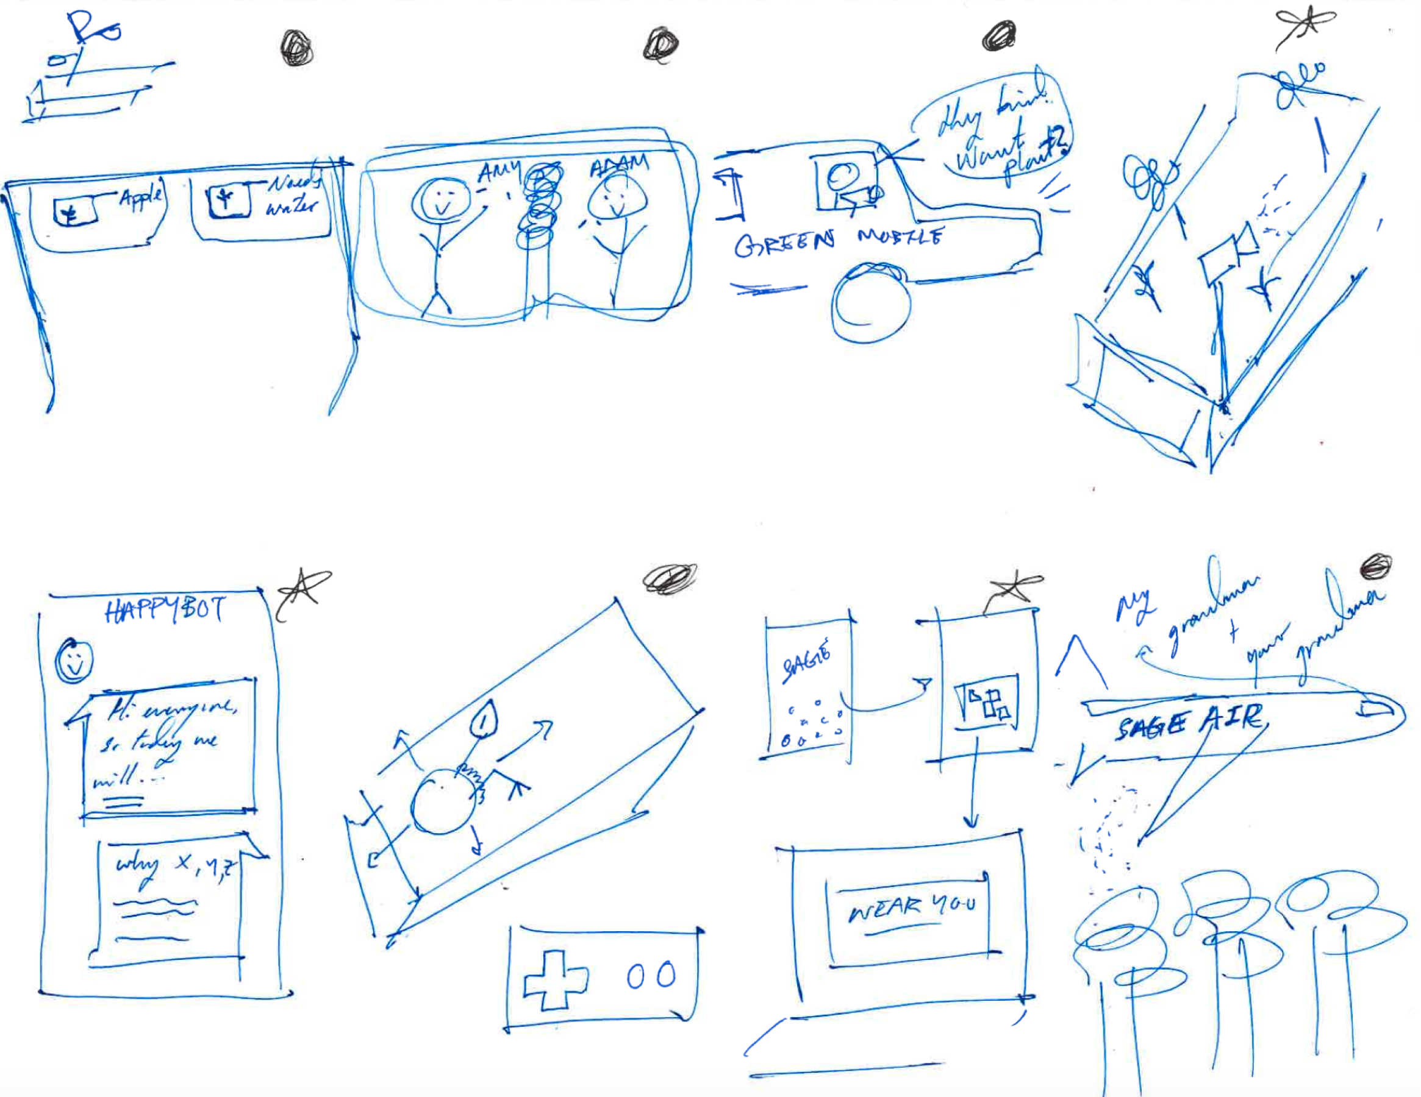

Slide 12
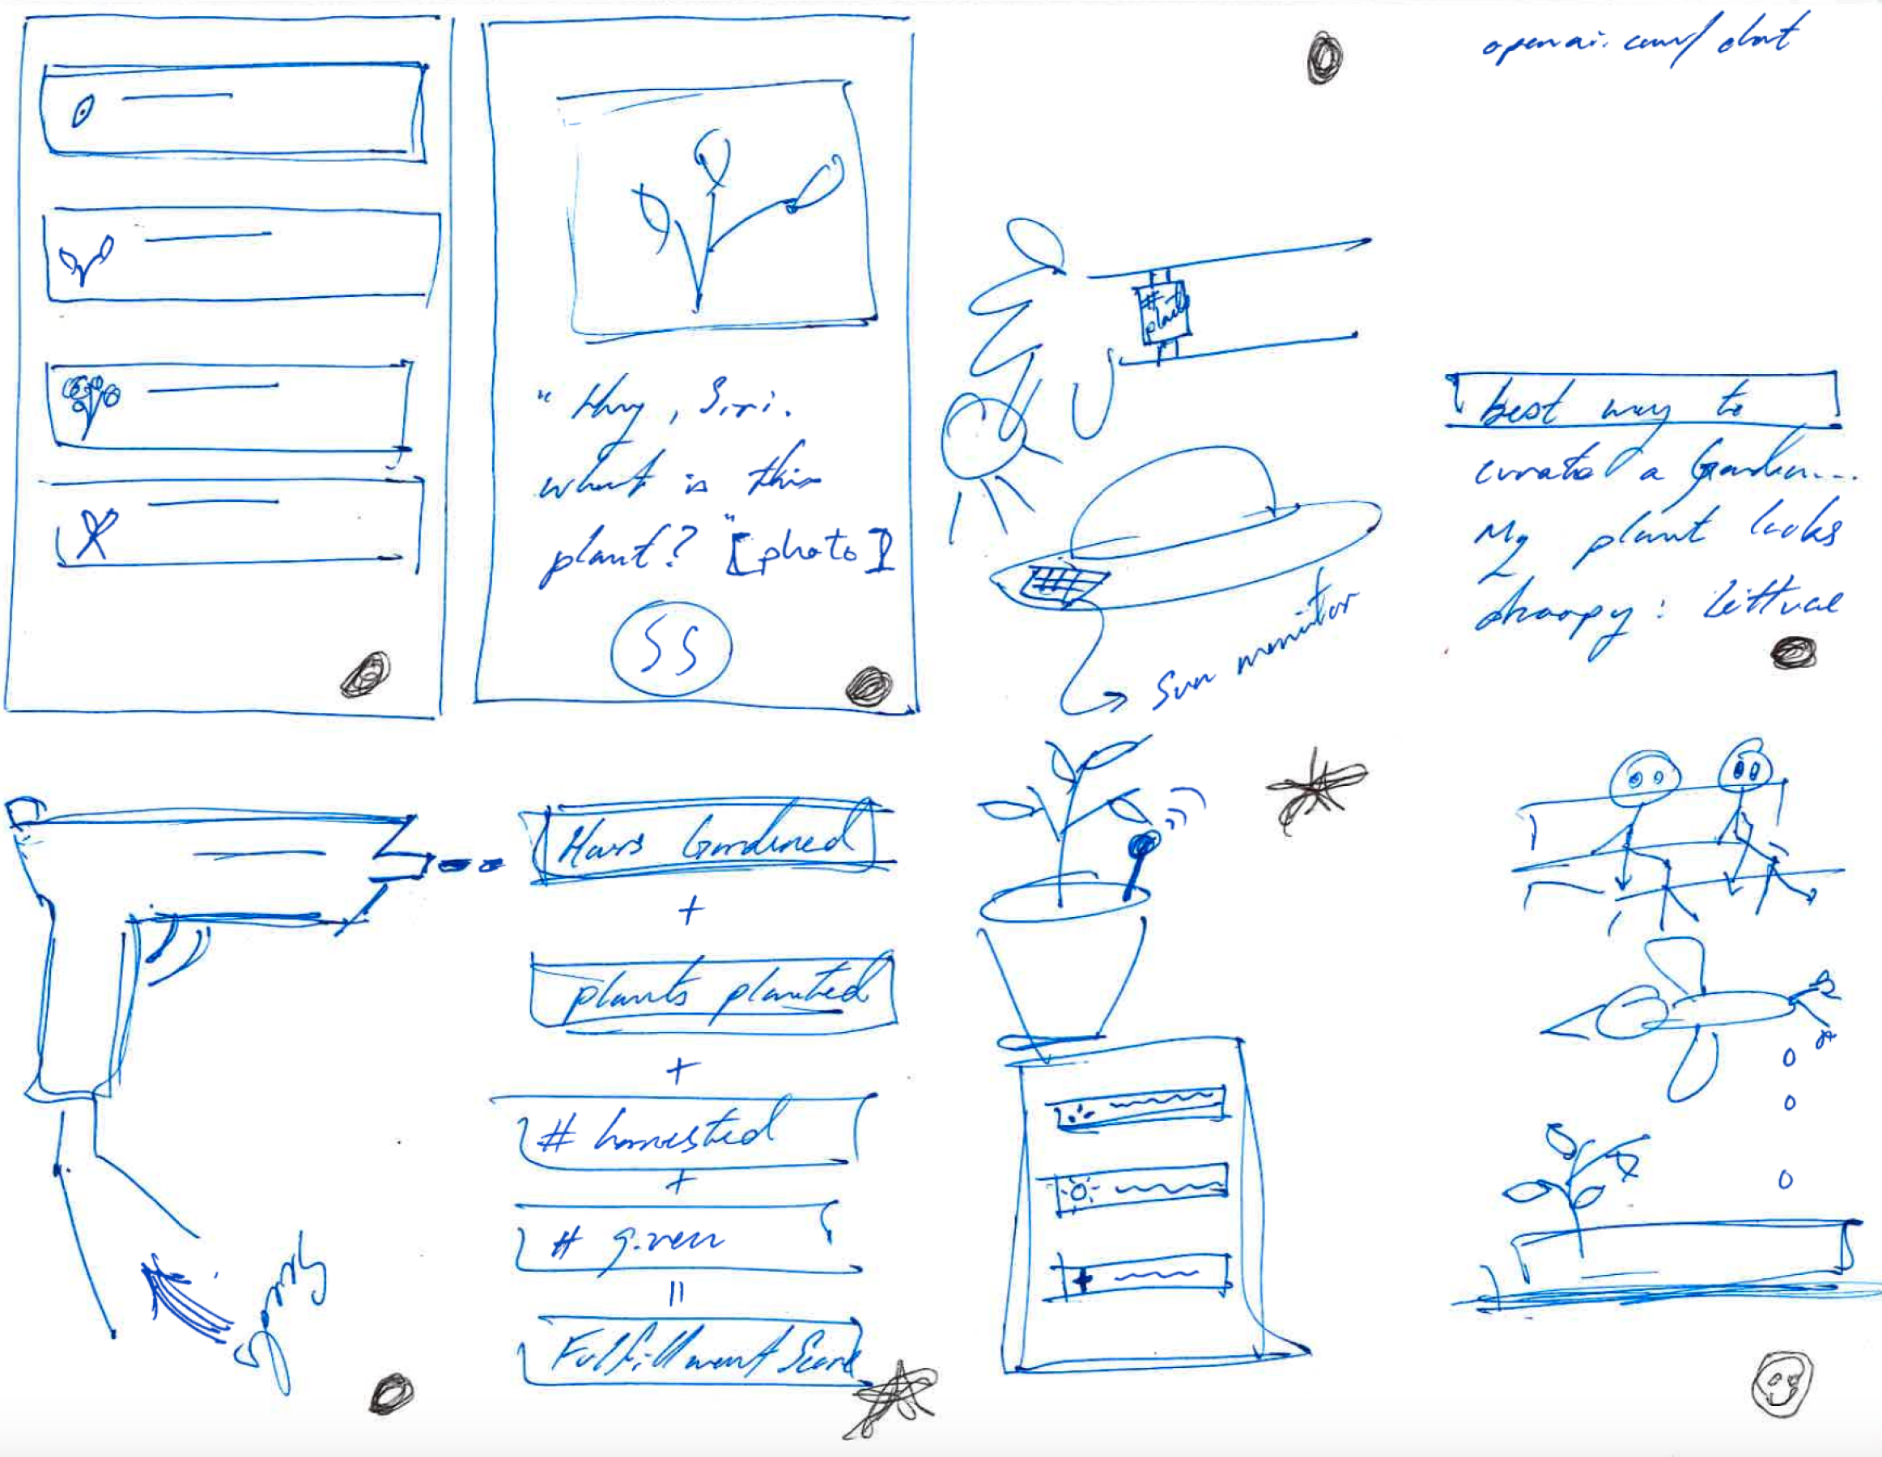

Slide 13
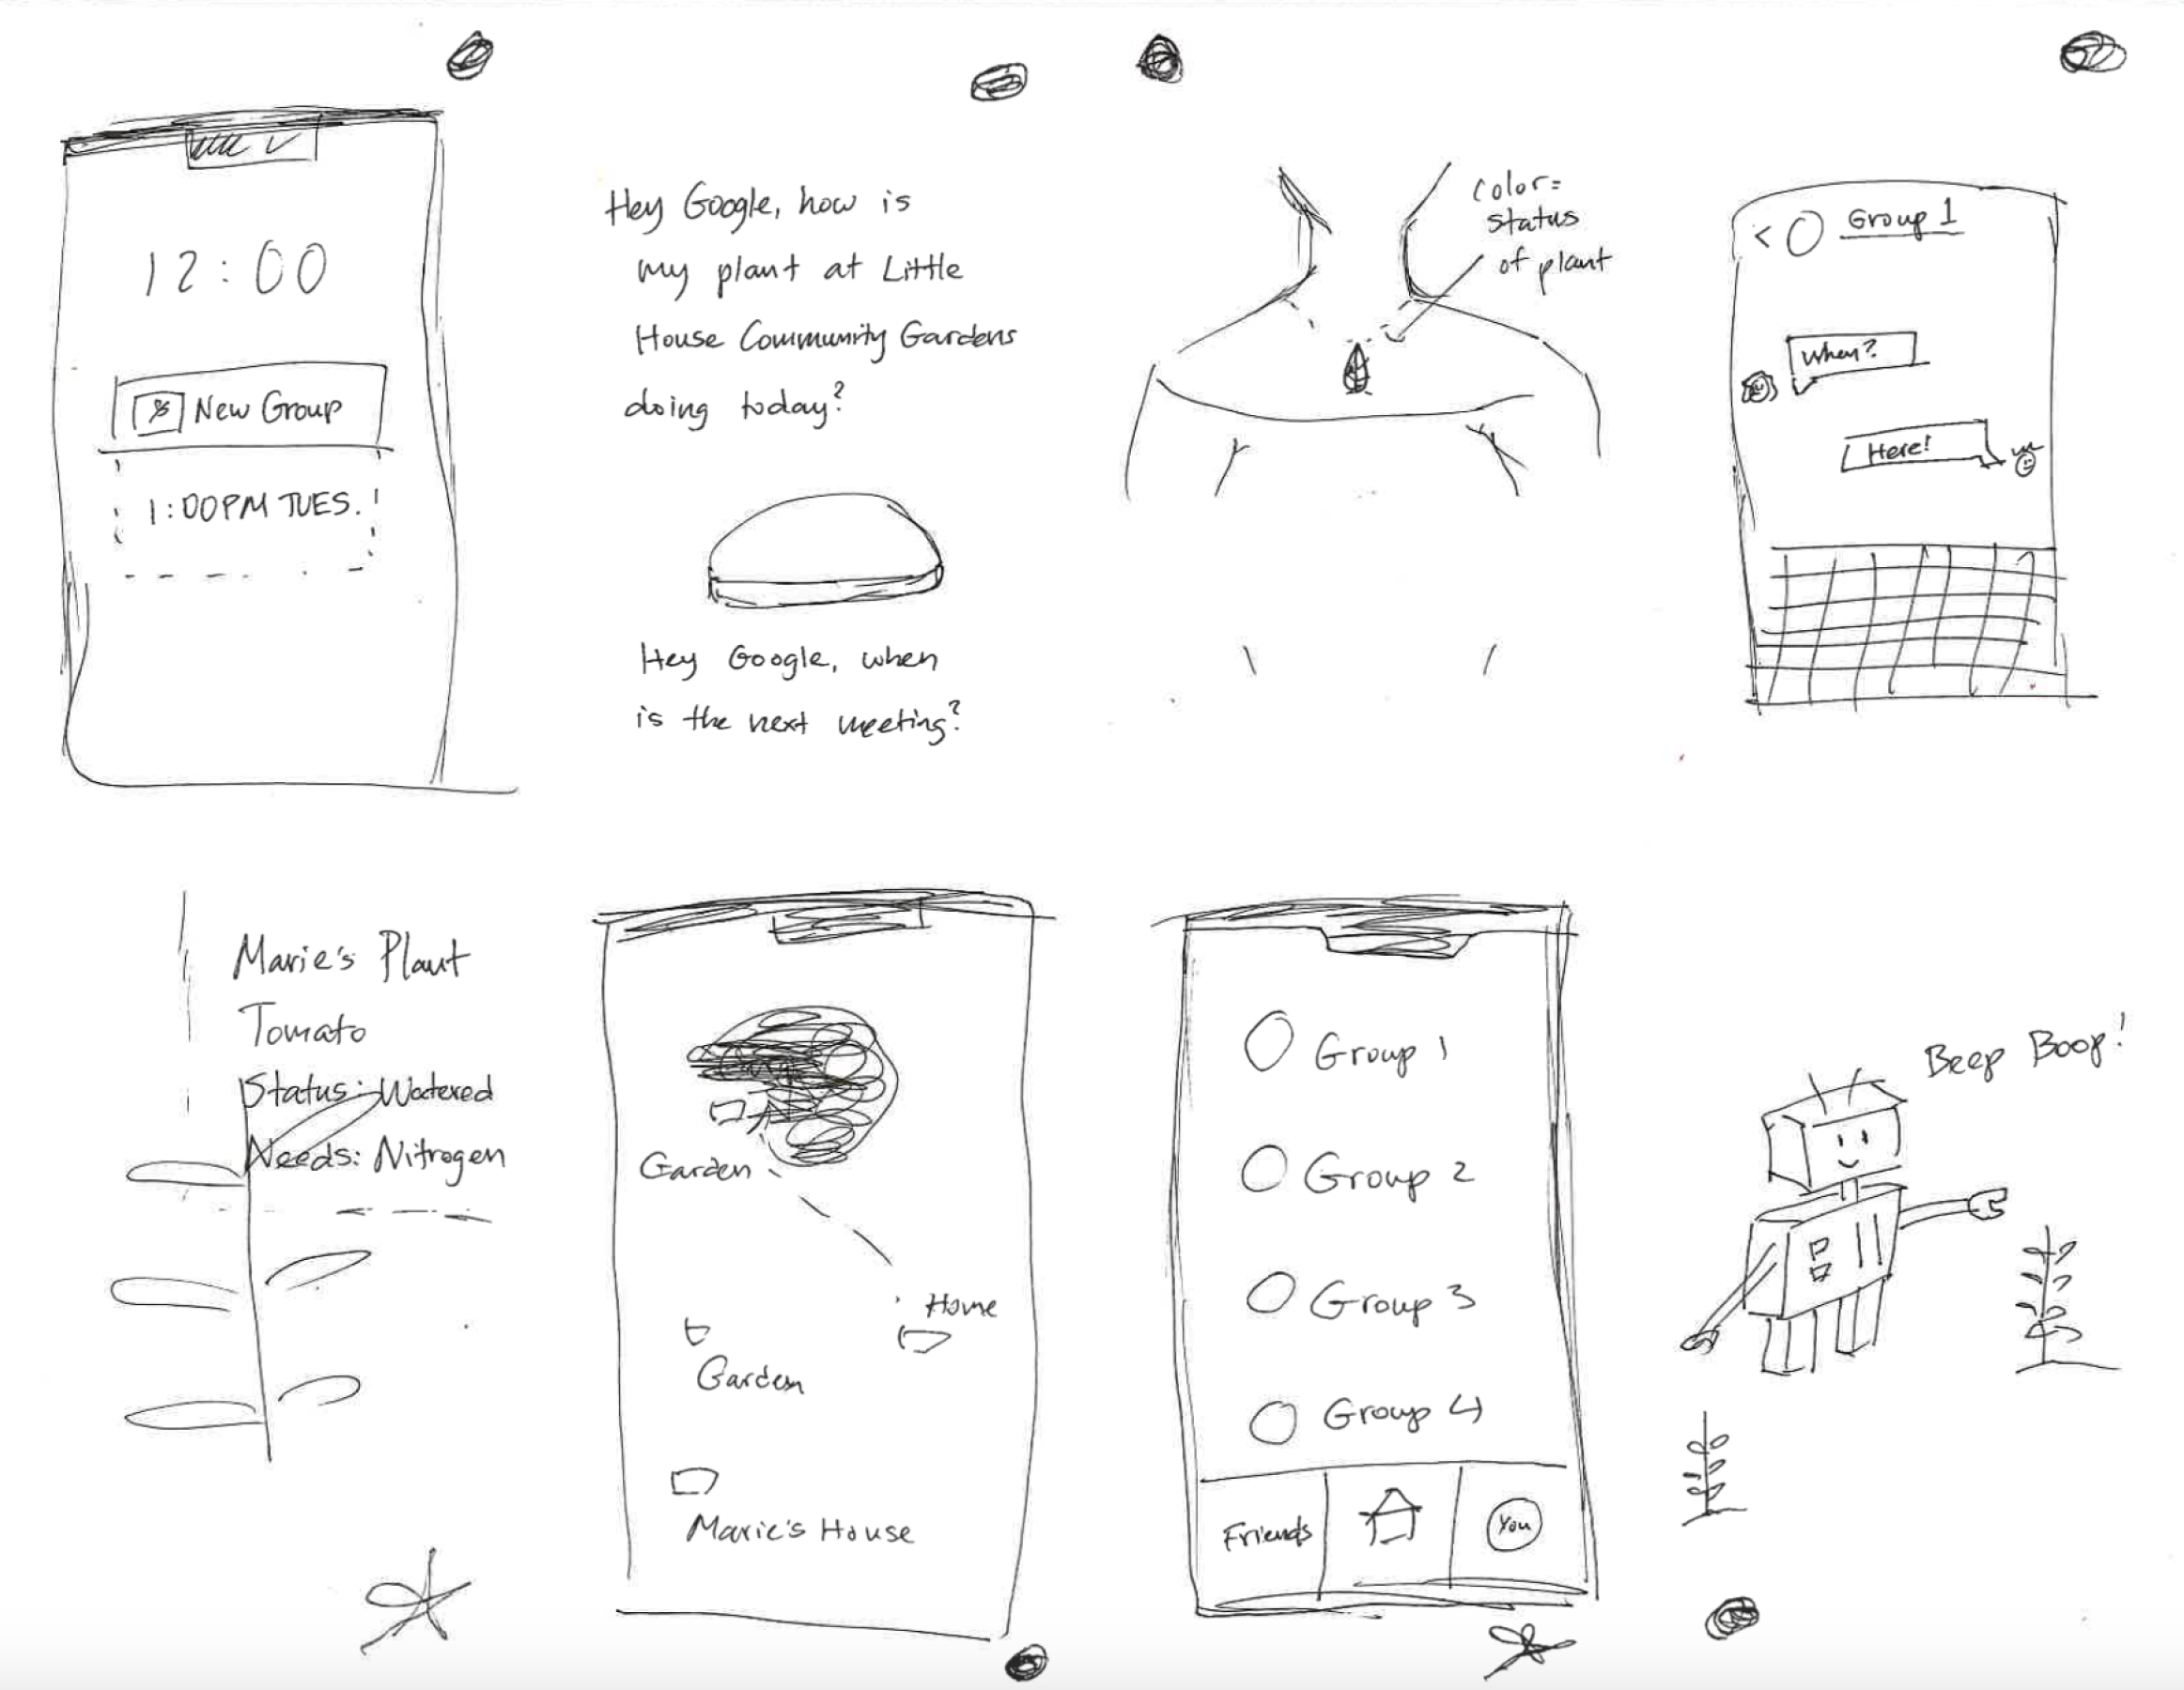

Slide 14
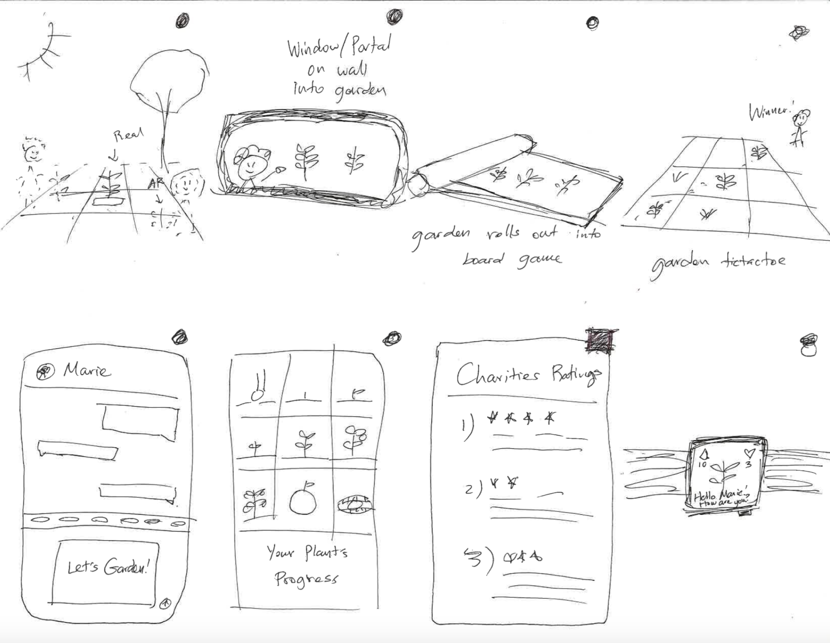

Slide 15
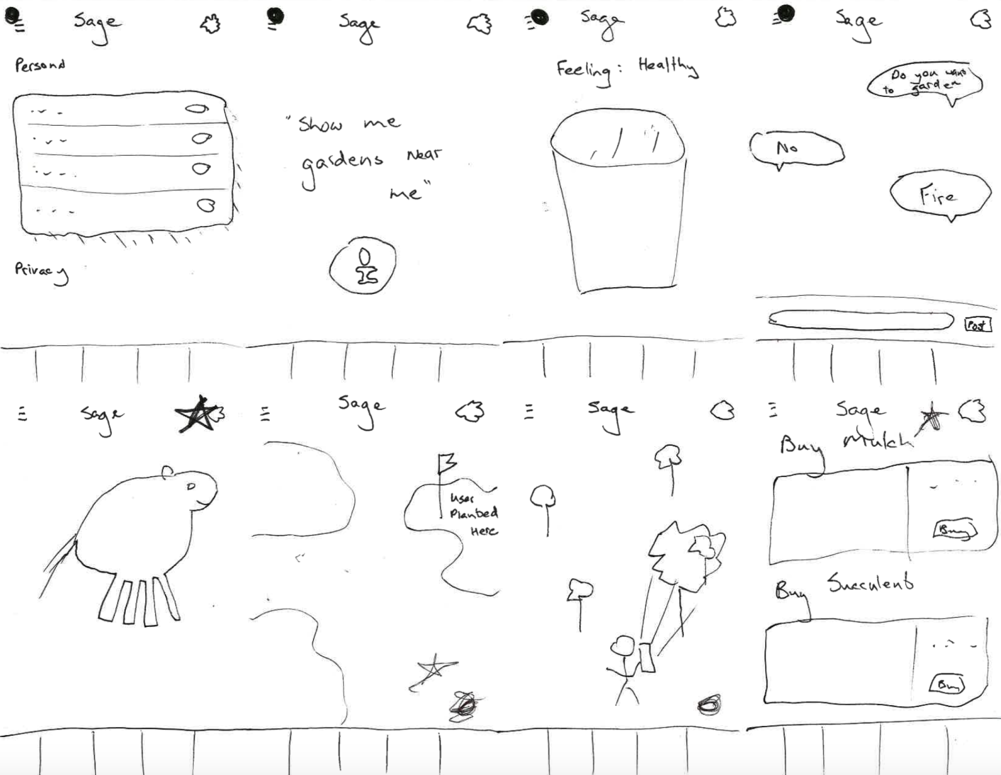

Slide 16
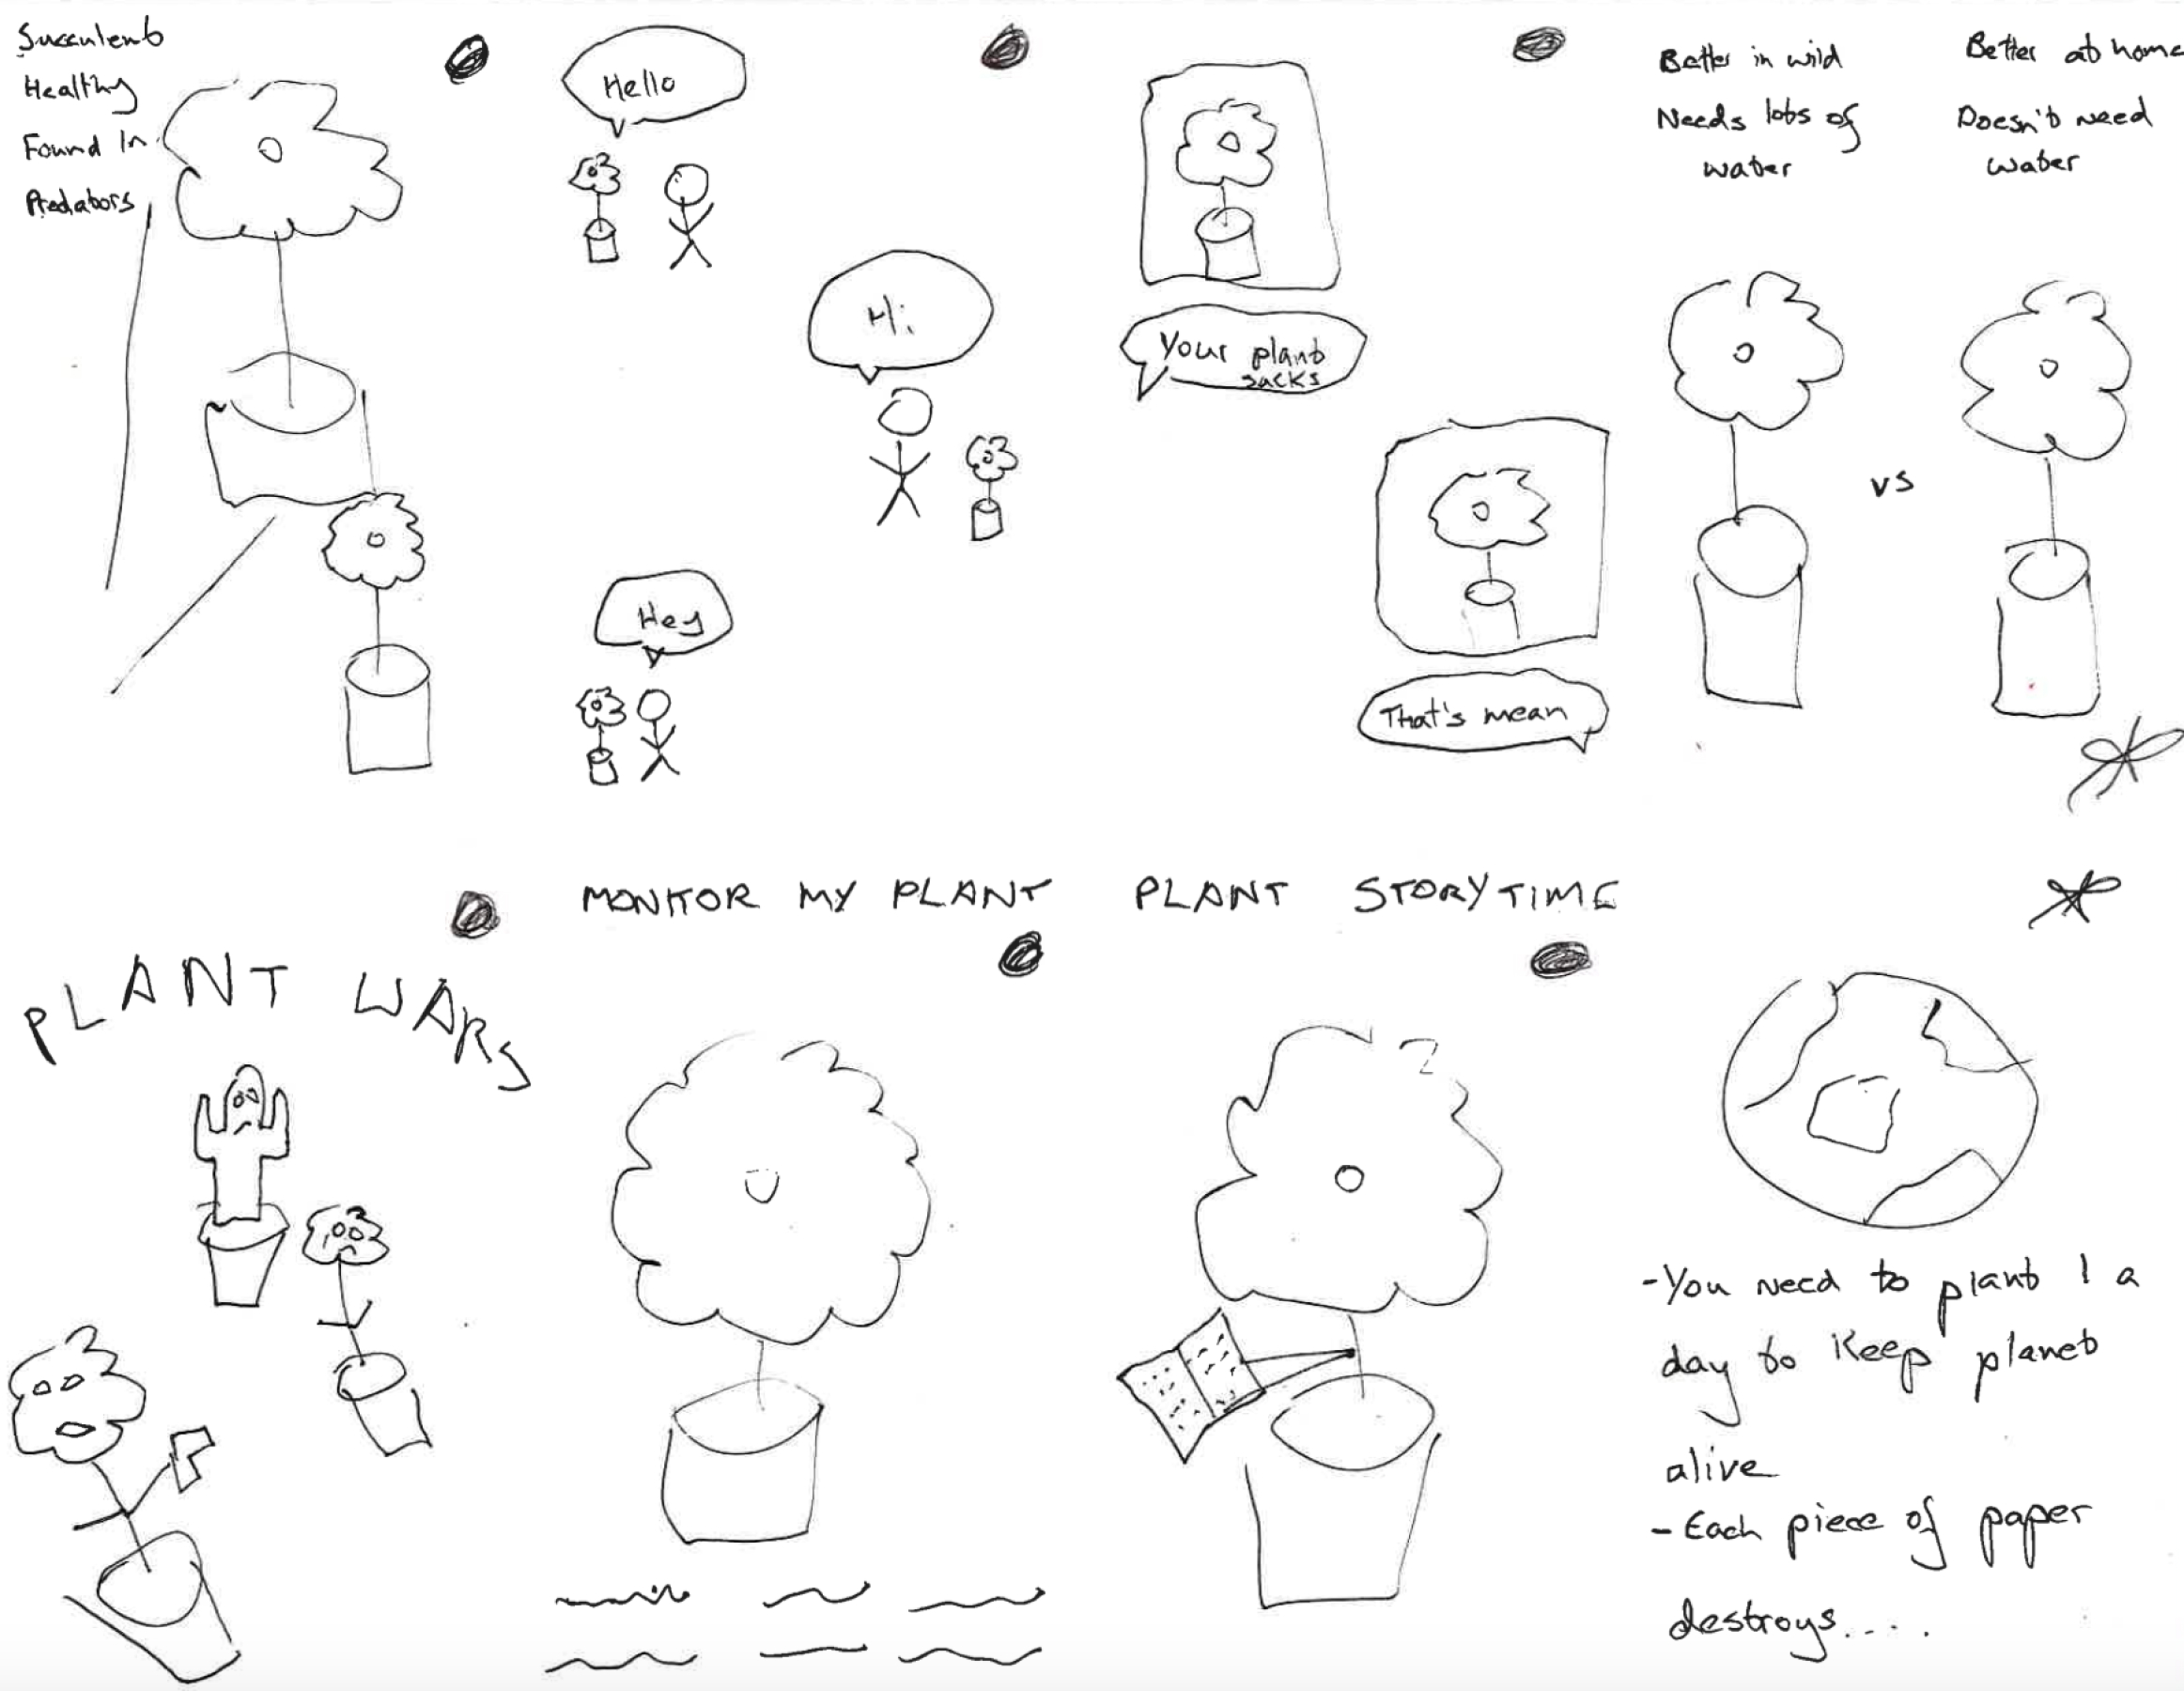

Slide 17
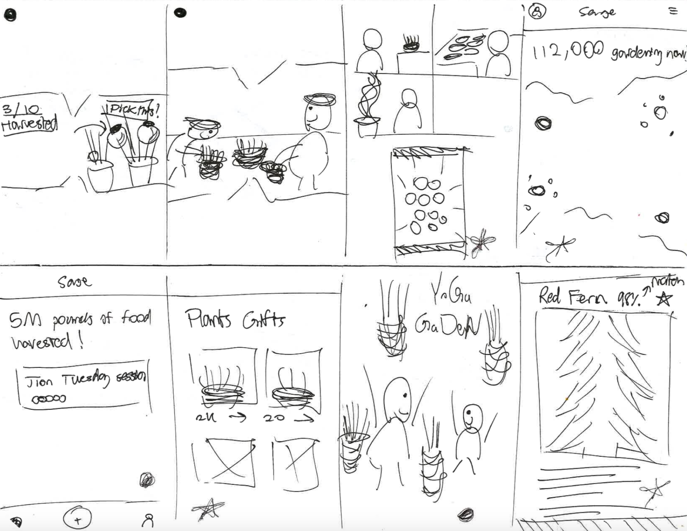

Slide 18
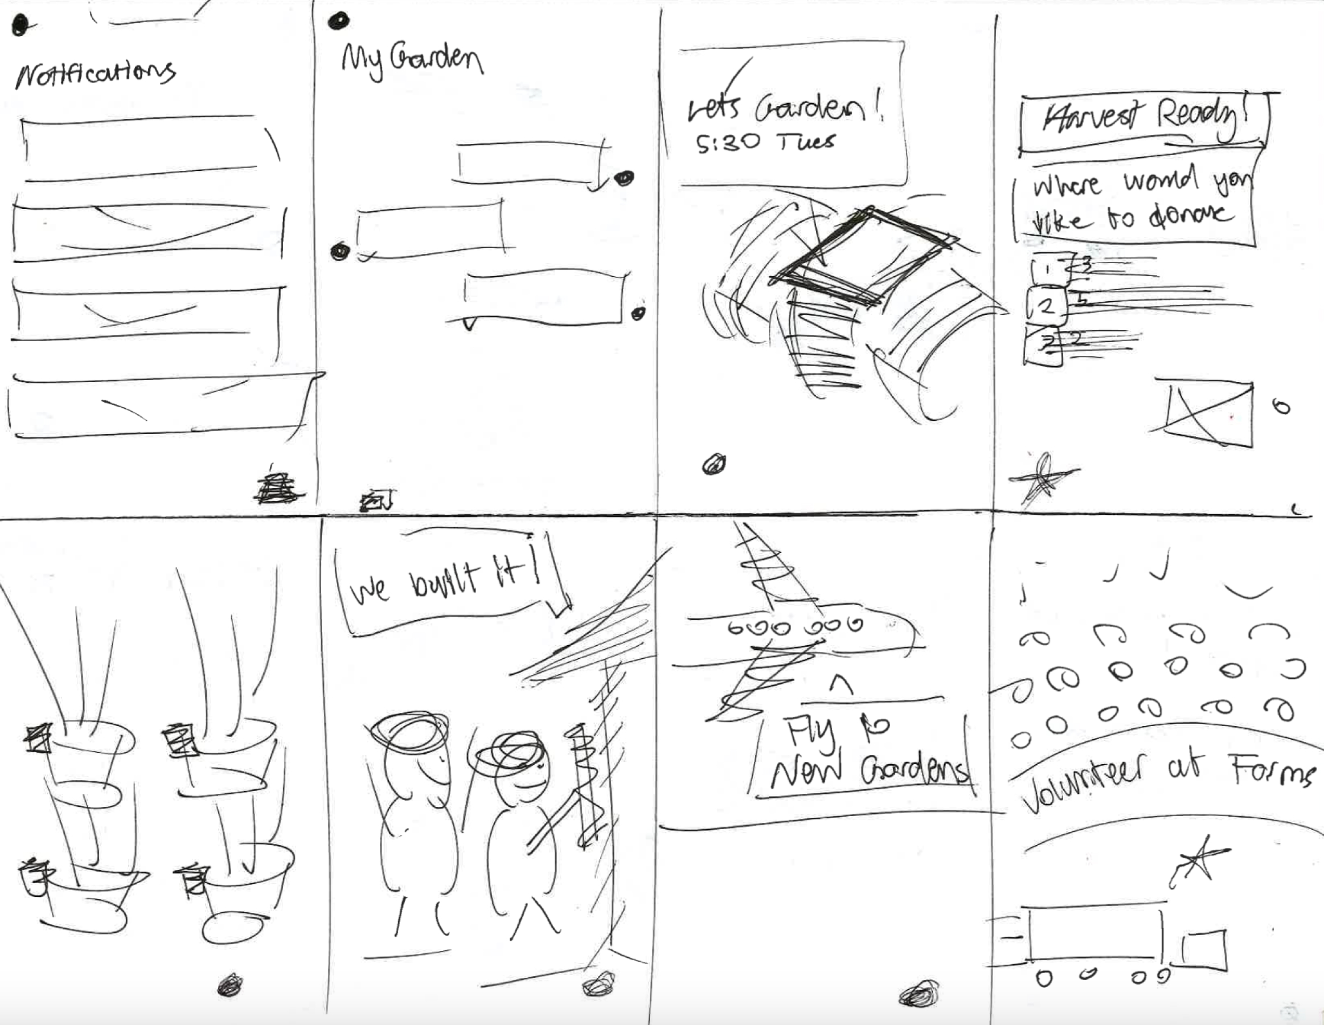

Slide 19
Solution Realizations

Slide 20
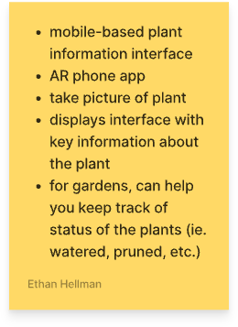
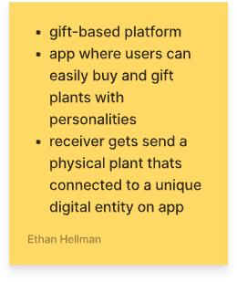

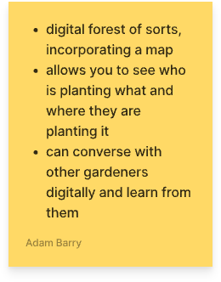
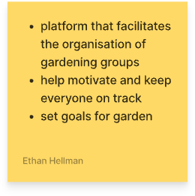
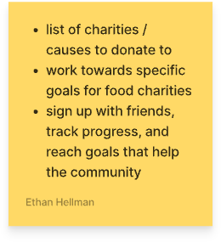





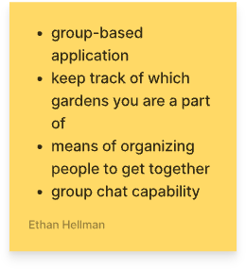
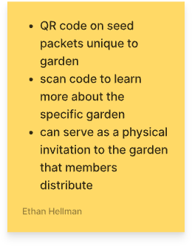
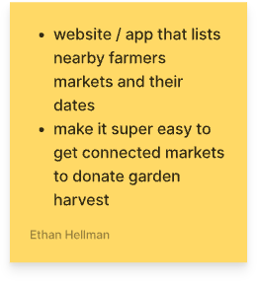
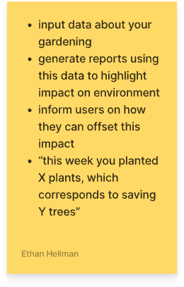

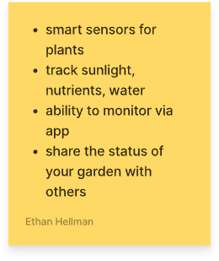


Solution Realizations

Slide 21
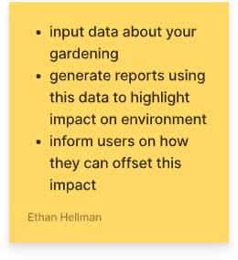
Solution Realizations
Distilled Realizations

Slide 22
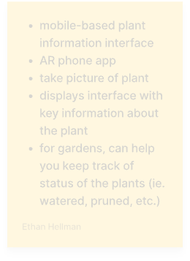
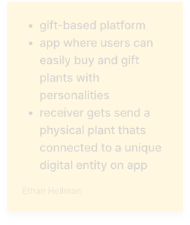
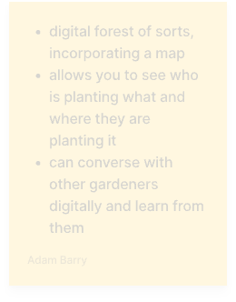
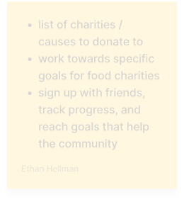


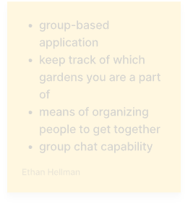
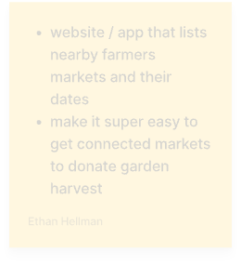
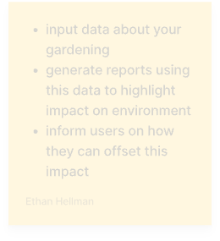
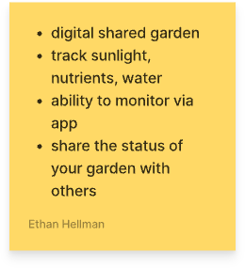
Solution Realizations
Distilled Realizations

Slide 23
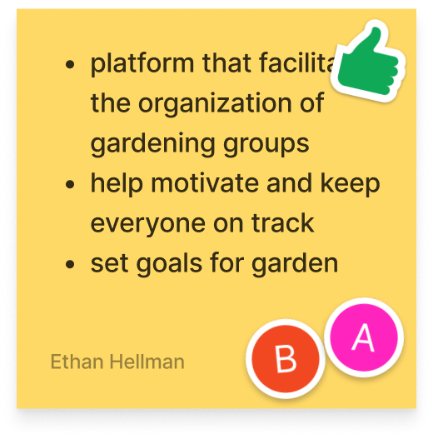
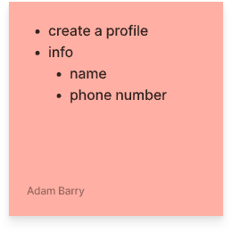
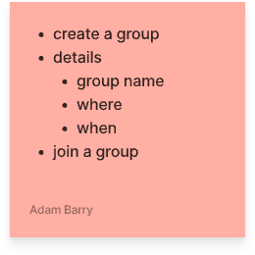
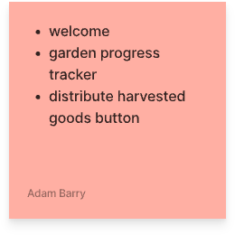
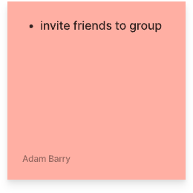
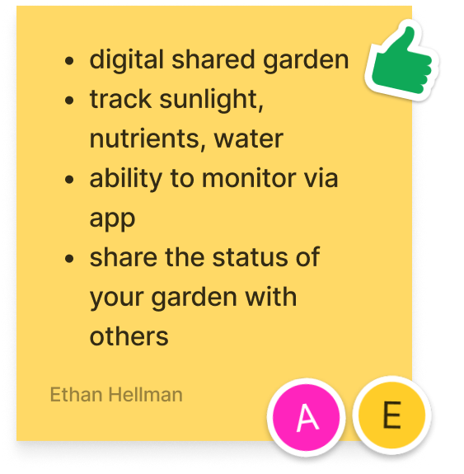
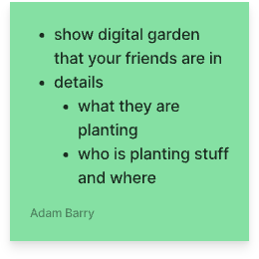
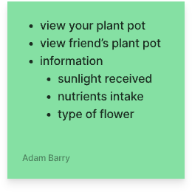
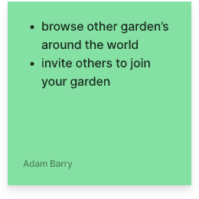
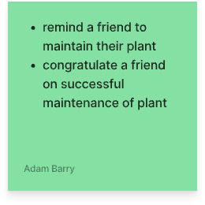
Solution Realizations
2 Realizations

Slide 24
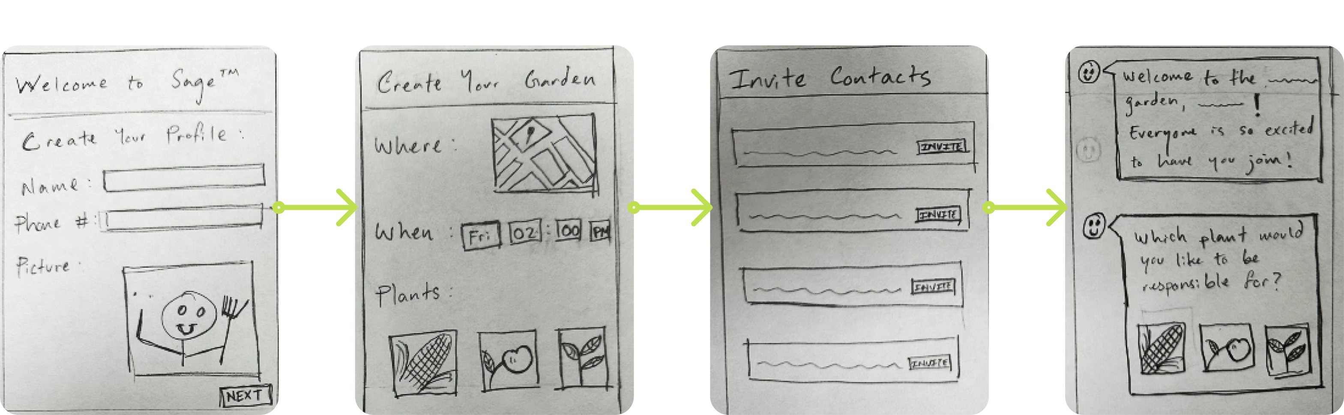
Solution Realizations
SOLUTION 1:
App that facilitates formation of gardening groups
Welcome
Create Garden
Invite Friends
Choose supplies

Slide 25
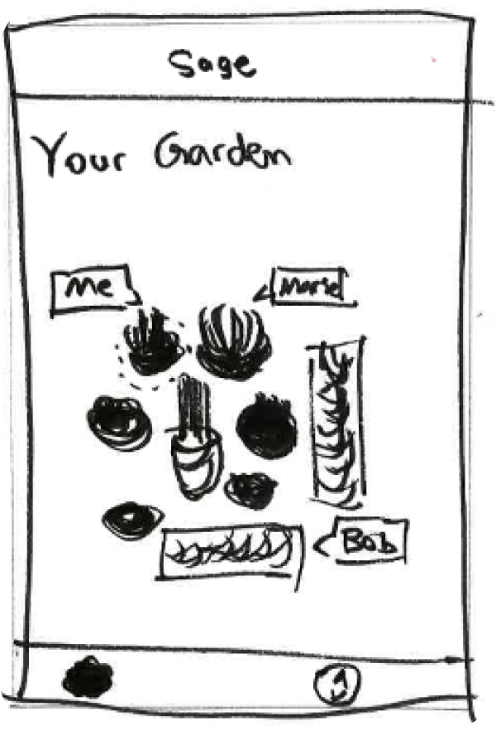
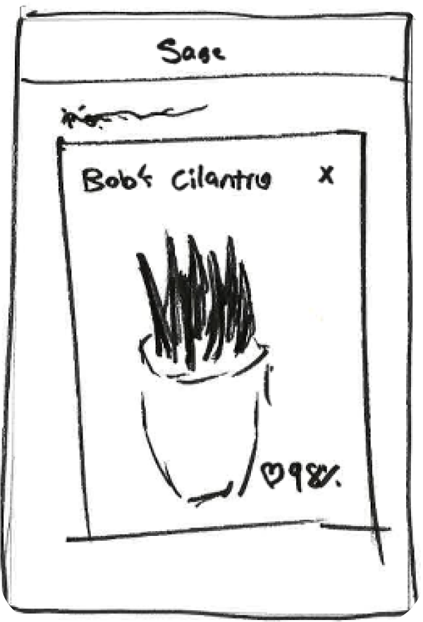
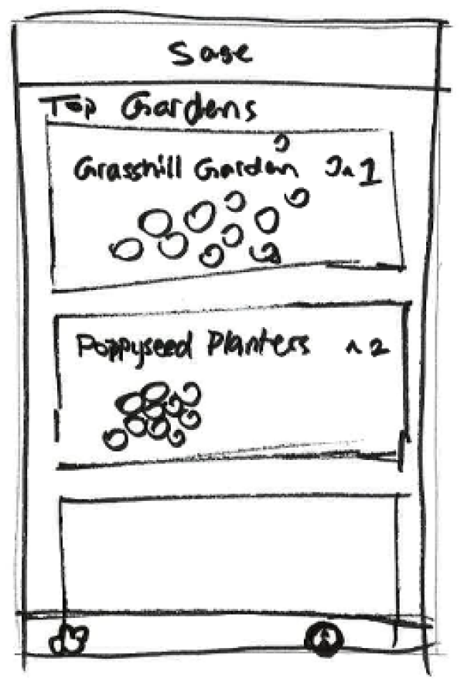
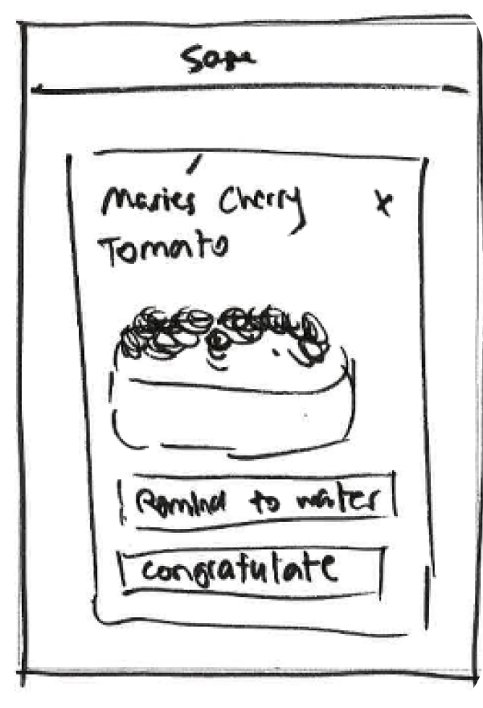
Solution Realizations
SOLUTION 2:
Digital Shared Gardens
Your Garden
View Plant
Browse Gardens
Interact with Plants

Slide 26
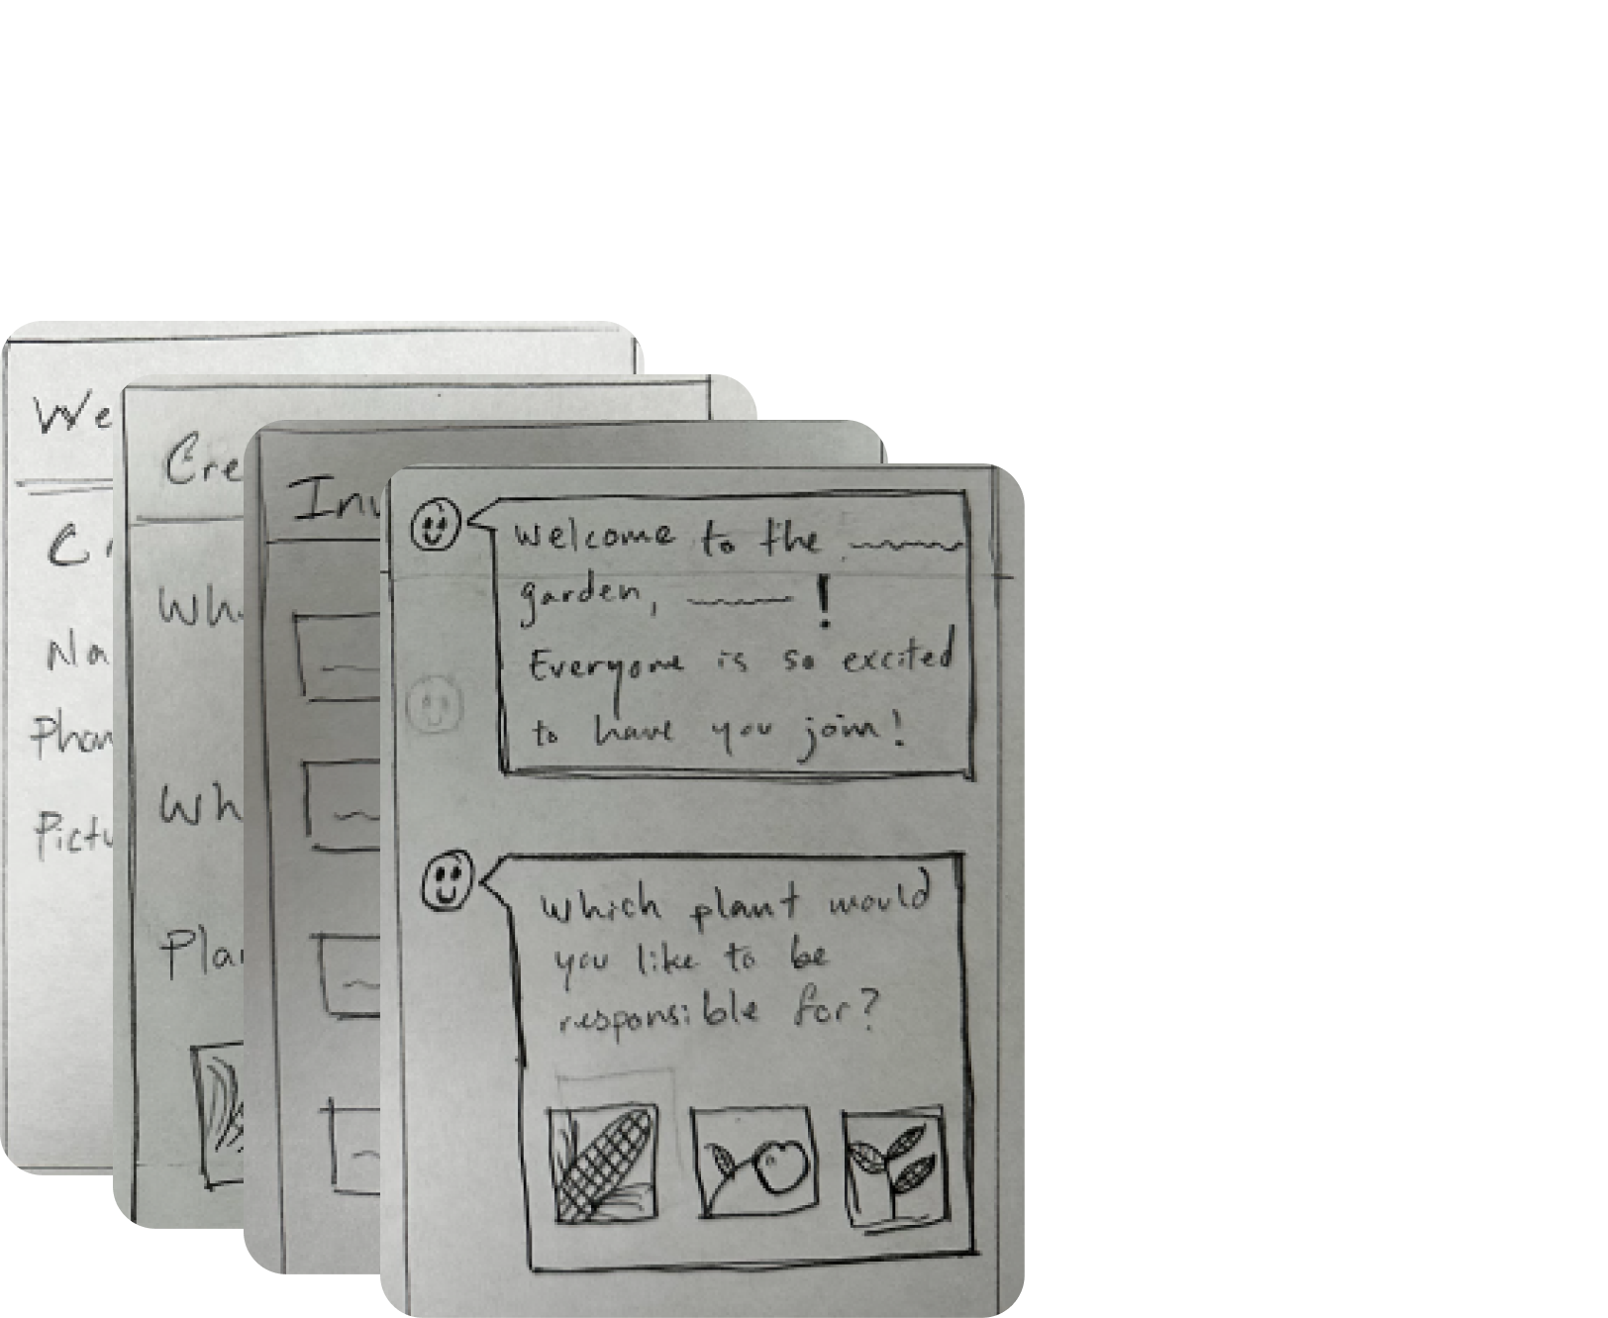
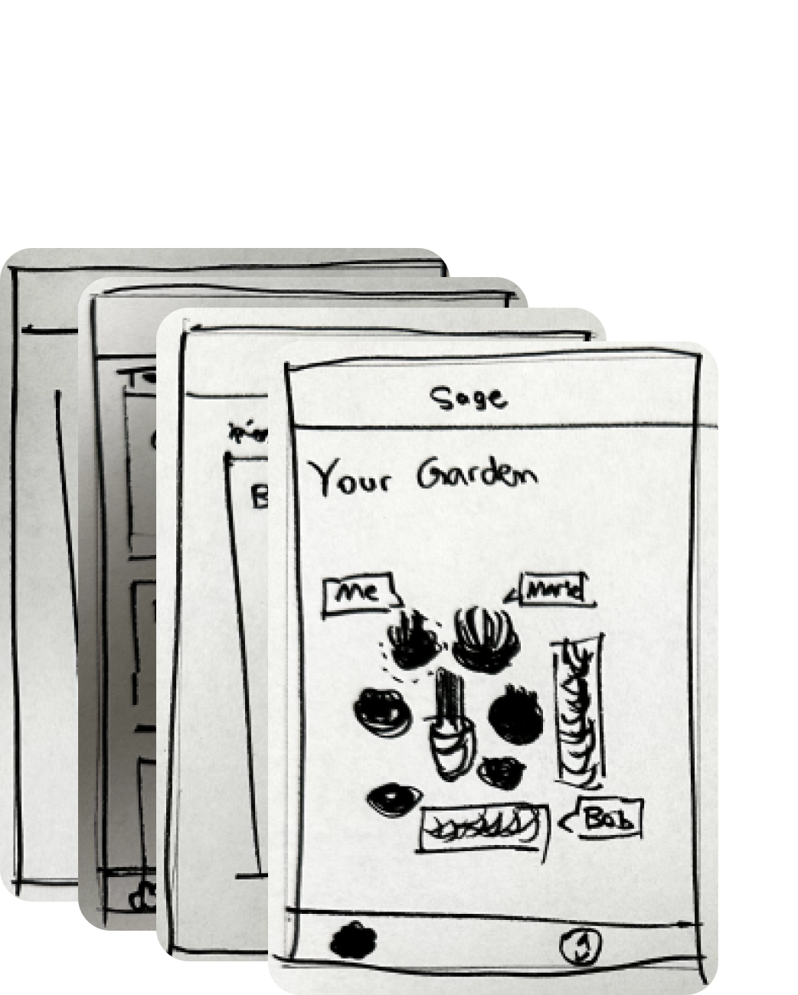
Selection Rationale
SOLUTION 1:
SOLUTION 2:
App for garden group formation
Digital Shared Gardens

Slide 27

Selection Rationale
SOLUTION 1:
App for garden group formation
PROS
Lowers activation energy for in-person activity
Incentivizes donation to charity
Focuses on journey of forming a group and meeting up
CONS
Requires more overhead: supplies, travel, new people
The value prop of planning thru app could be obscure

Slide 28

Selection Rationale
SOLUTION 2:
PROS
Digital Shared Gardens
Adds feeling of community without overhead
Enables connection from a distance
CONS
This solution might appeal more to a younger user group
Focuses on the actual plants more than spending quality time
No physical activity or in-person interaction

Slide 29

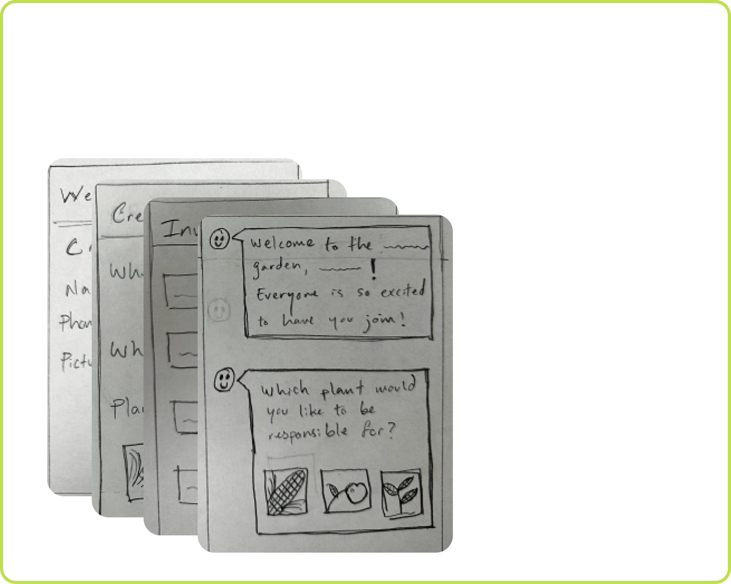
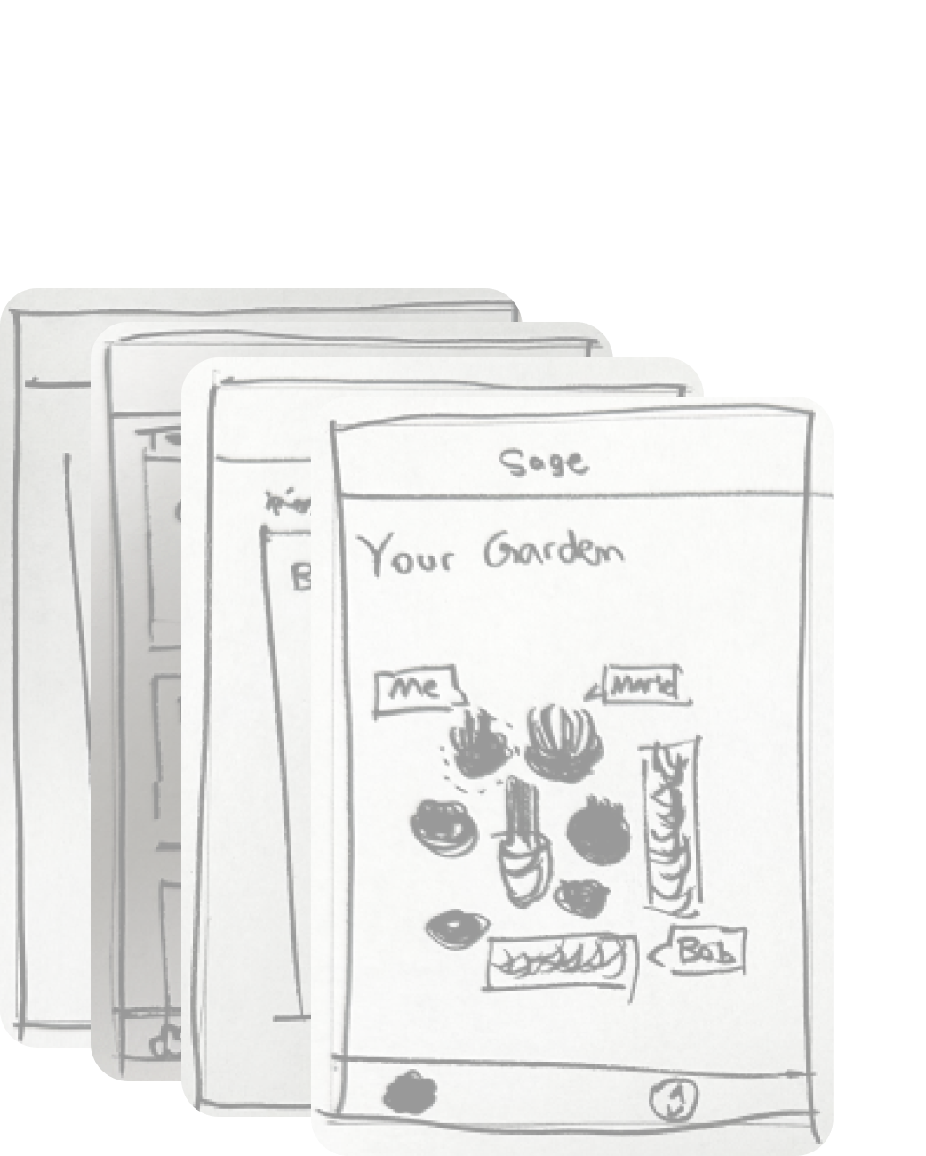
Selection Rationale
SOLUTION 1:
SOLUTION 2:
App for garden group formation
Digital Shared Gardens

Slide 30

Selection Rationale
SOLUTION 1:
SOLUTION 2:
App for garden group formation
Digital Shared Gardens
It’s about people, not plants The hard part is the organizational overhead For our users, the less UI the better

Slide 31
Task Flows

Slide 32

Task Flows
SIMPLE
Invite new group members
MODERATE
Join Sage and find when and where to garden.
COMPLEX
Distribute harvested food to the community

Slide 33

SIMPLE TASK
Invite new group members

Slide 34

MODERATE TASK
Join Sage and find when and where to garden

Slide 35

COMPLEX TASK
Distribute harvested food to the community

Slide 36

Lofi Prototype

Slide 37


Slide 38


Slide 39



























LoFi Prototype
Old Prototype
Marie Apple
Marie Apple
Gilli’s Garden
650 999-9999
Marie Apple
Marie Apple
Gilli’s Garden
650 999-9999

Slide 40



LoFi Prototype
Old Prototype
Marie Apple
Marie Apple
Gilli’s Garden
650 999-9999
Marie Apple
Marie Apple
Gilli’s Garden
650 999-9999

Slide 41


LoFi Prototype
Old Prototype
Chat UI too heavy and text-reliant for lofi prototype
Marie Apple
Marie Apple
Gilli’s Garden
650 999-9999
Marie Apple
Marie Apple
Gilli’s Garden
650 999-9999

Slide 42







































LoFi Prototype
New Prototype
Marie Apple
Marie Apple
9
Jilli’s Garden
12
12
12
30
30
Jilli’s Garden
Marie Apple
Marie Apple
Please come join my garden! We meet every Wednesday at 3pm.
650 999-9999
Jilli’s Garden
Jilli’s Garden
Jilli’s Garden
Jilli’s Garden
Jilli’s Garden
Jilli’s Garden
Please come join my garden! We meet every Wednesday at 3pm.
Little House Center
Little House Center
Little House Center
Little House Center
Little House Center
09
09
09
33
33

Slide 43







LoFi Prototype
Simple Task Flow
Please come join my garden! We meet every Wednesday at 3pm.
Please come join my garden! We meet every Wednesday at 3pm.
Invite new group members

Slide 44














LoFi Prototype
Moderate Task Flow
Jilli’s Garden
Join Sage and find when and where to garden

Slide 45









LoFi Prototype
Complex Task Flow
Distribute harvested food to the community

Slide 46
Testing Methodology

Slide 47


Testing Methodology
Configuration
DEMOGRAPHIC
ENVIORNMENT
MATERIALS
Tables inside and outside
Elderly
Elderly
OUR TEAM
Ethan: Computer/App
Adam: Notetaker
Middle Aged
Young Adult

Slide 48


Testing Methodology
Goals
USABILITY
METRICS
Intuitive → important for a non-technical user demographic Obvious → application needs to clearly provide value to the user Useful → application should provide value on a long term basis Fun→ interface should be appealing for users
Intuitive Navigation Apparent Utility Repeat Usage Likeability

Slide 49


Testing Methodology
Procedure
Approach participant and sit down at table Instructions, consent, and context Participant walk through prototype and think out loud

Slide 50
Testing Results

Slide 51

Testing Results
Mollie
Tried login and join without registering or having group Confusion with the idea of being a first time user Some general UI component confusion “Harvest or invite first?” “Why is there an option to edit message?” Next buttons rarely used to advance screen Thought the flow of the app was intuitive

Slide 52

Testing Results
Caitlin
“What name should I put for ‘join garden’?” “How is progress was measured?” Wanted list of people already in garden Couldn’t distinguish what the options were on the home page Wanted the option to assign different tasks to different gardeners Login page confusion Harvest page confusion

Slide 53

Testing Results
Corliss
Wants a summary of what happened in previous event Loved the congratulations page Confusion on logging page Wants to assign jobs / responsibilities Harvest must be a celebration - animation, congratulations, etc Include pictures of those who helped commit to the garden’s harvest

Slide 54

Testing Results
Christo
Navigation confusion Liked the layout of the app Found interactive components intuitive to use Enjoyed being able to invite lots of his contacts Wants the option to invite people over Snapchat / Instagram

Slide 55


Testing Results
Big Picture Takeaways
INTUITIVE NAVIGATION
Flow of app is intuitive
Enables connection from a distance
APPARENT UTILITY
Need to make utility of app more apparent
Need to think about repeat usage. Users did not seem inclined to come back
LIKEABILITY
More colors and animation
REPEAT USAGE
Keeping track of our garden needs to be more apparent
Social / community aspect needs to be more apparent

Slide 56
Discussion

Slide 57
Discussion
Implications: Does not communicate value clearly enough (repeat usage?) Increased emphasis on community makes app more appealing Difficulty in understanding how to track garden progress Consult a broader audience Changes to be made: “Higher-energy” design Calendar & Time Login process Create / Join process Testing could not reveal: Usage over time (how does app help garden over course of harvest) Ease in communicating with third parties (ie. charities for donation) Difficulty in measuring “fun”

Slide 58
Appendix
Interview Segment 1
Interview Segment 2
Pro’s & Con’s Full List
Storyboards
FigJam Board
Sketching Report
Lo-fi Prototype
Script
Critical Log

